Slide 1
Farmers for Climate Action
Verity Morgan-Schmidt, CEO
@farmingforever

Slide 3
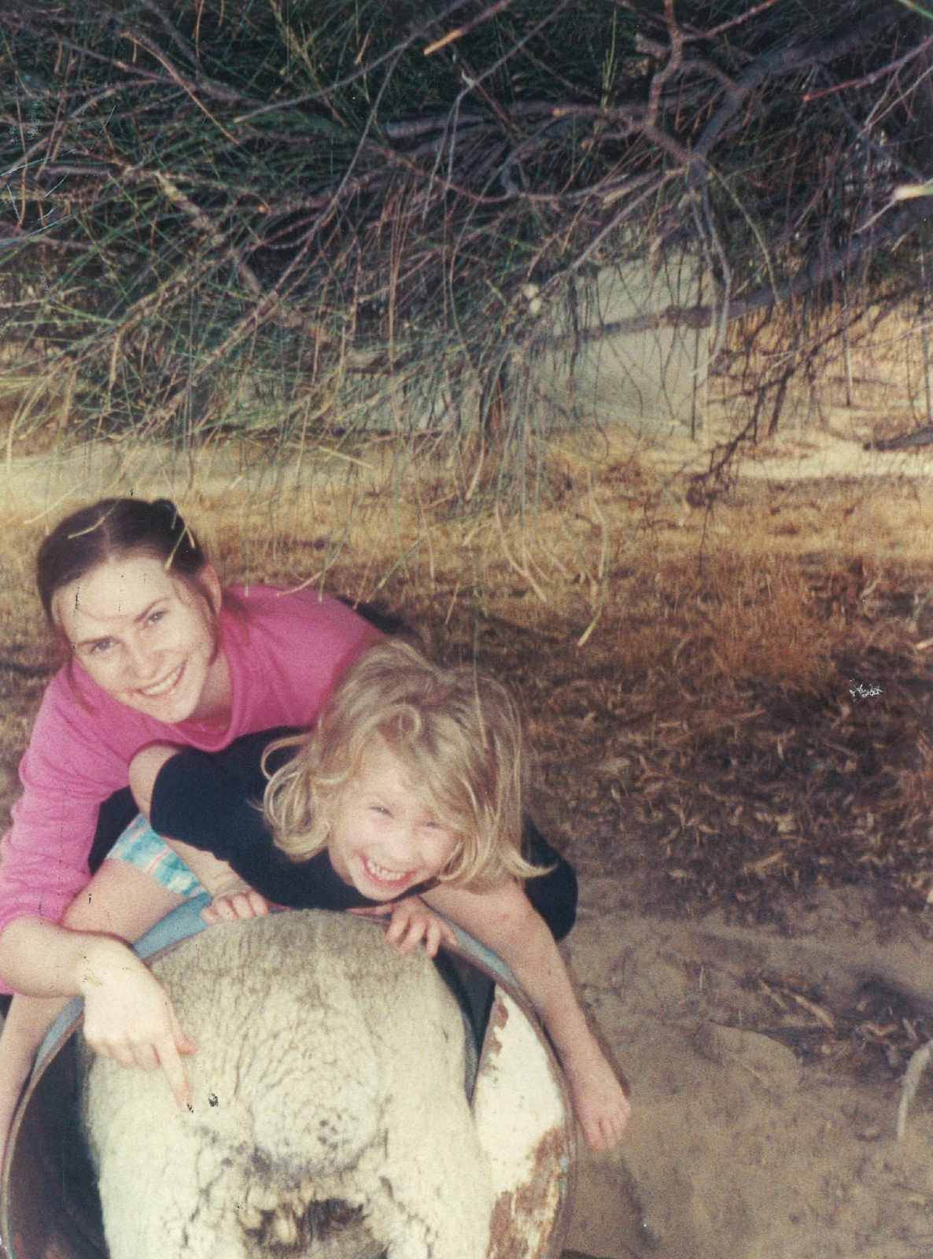
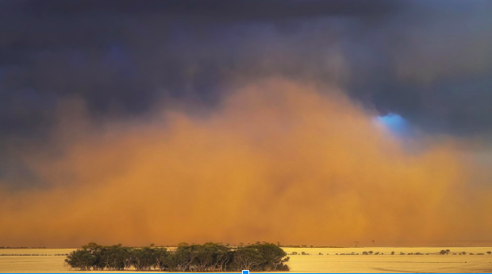
My story

Slide 4
Our vision: farming forever
Farmers for Climate Action is an inclusive movement of farmers, graziers and agricultural industry leaders committed to putting those on the front line of climate change front and centre in creating solutions.
3,000+ farmers across Australia
25,000+ supporter base across Australia
Media reach (last 30 days) – 3.3m

Slide 5
We are committed to
Supporting farmers to build climate, energy and political literacy and adaptive capacity
Keeping agriculture on ‘the front foot’ and working with the agricultural sector to put those on the front line of impacts – front and centre in solutions
A strictly non-partisan approach; working with all sides of politics to advance robust, evidence based climate and energy policy.

Slide 6
Our Objectives:
1. Increase the uptake of climate smart agriculture across the agriculture sector.
Sustainably increasing agricultural productivity and profitability
Adapting and building resilience to climate change
Reducing and removing greenhouse gas emissions.
2. Mobilising farmers to lead the clean energy transition – driving the benefits to rural and regional Australia
3. Empowering the agriculture sector and rural Australia to advance climate action.
Building farmers and graziers voices as leading voices in the national debate on climate and energy

Slide 7
How do we work?
We engage through a community organising approach; working directly with farmers to recruit other farmers.
We inform through our capacity building work; upskilling our farmers in climate science and policy. We are a trusted, non-partisan voice for stakeholders across government and the broader community. We link the best experts in the lab with the best experts in the field.
We mobilise by inspiring famers to achieve and advocate climate action behind and beyond the farm gate.

Slide 8
Climate change & western australia
Temperature increase 1.1 – 5.1 degrees by 2100 (emissions scenario dependent)
Rainfall decline – 6% by 2030 (impacting growing season rainfall and resulting in rainfall zones shifting south)
Sub-tropical ridge shifting south: cold fronts tracking lower
Anecdotal evidence indicating increased late season frost risk (the Frost Paradox)
WA as the canary in the climate coal mine – significant biodiversity and resilience decline

Slide 10
Impacts
Rising sea levels – increasing impact of storm surges
Coastal erosion
Changing rainfall patterns (declining in SW Australia)
Increasing frequency and severity of drought conditions
Increasing heat stress for plants and animals
Reduced livestock, plant and forestry productivity
Increasing bushfire risk

Slide 11
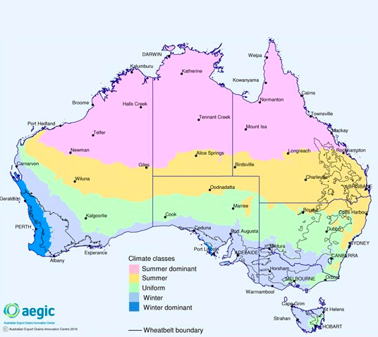
Shifting rainfall zones

Slide 12
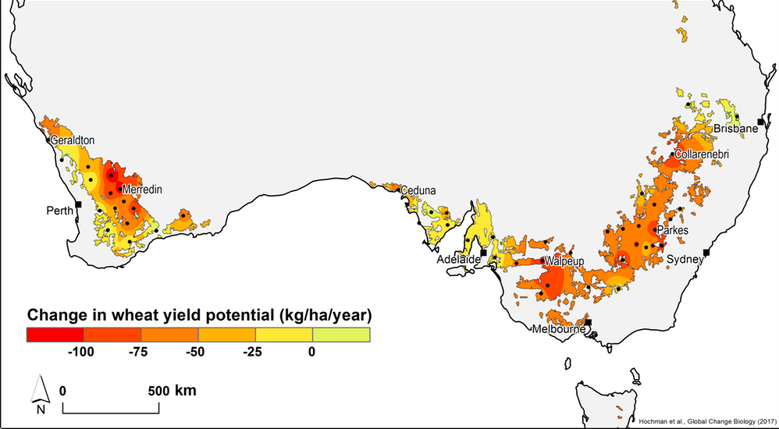
Impact on wheat yields

Slide 13
Are we heading in the right direction?

Slide 14
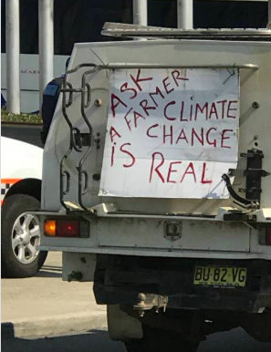

Slide 15
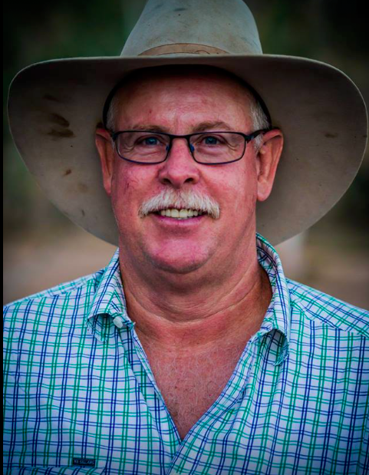
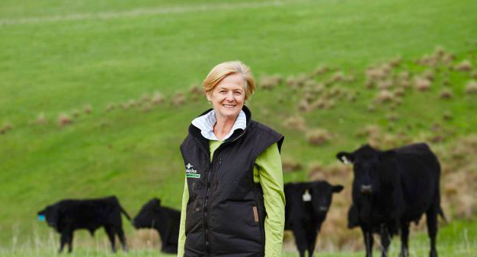
Our farmers

Slide 16
Climate Smart Agriculture
Climate Smart Agriculture Masterclass (Victoria)
Climate & Energy Literacy Workshops & Webinars
National Strategy on Climate Change & Agriculture
Linking production with policy – pulling the puzzle together

Slide 18
National strategy on climate change and agriculture
Comprehensive research on the direct and indirect risks climate change poses to Australian agri-food systems, including risks to primary production, biosecurity, food processing, food safety, farmer health, key infrastructure, equity, animal welfare, export markets, and farm inputs;
Short-, medium-, and long-term targets for adapting Aussie farming to climate change including a ‘just transition’ for regions that will struggle to maintain viability
Support for farmers to transition to ‘climate-smart’ agricultural practices that build resilience and reduce emissions, including funding for research, development, education, training and extension in this area;

Slide 19
National strategy on climate change and agriculture cont.
A long-term plan to promote clean energy in farming communities, including community-owned renewables projects that can provide sustainable, alternative income for farmers during drought;
A strong commitment to reduce emissions across all sectors of the economy, in a way that maximises benefits to farmers and rural communities, and investigating all options for supporting farmers to capture and maintain carbon in our soils and vegetation;
A commitment to stopping new coal and gas mines. Fossil fuel mines use water that we as farmers desperately need, and make climate change worse.

Slide 20
Clean energy transition

Slide 21
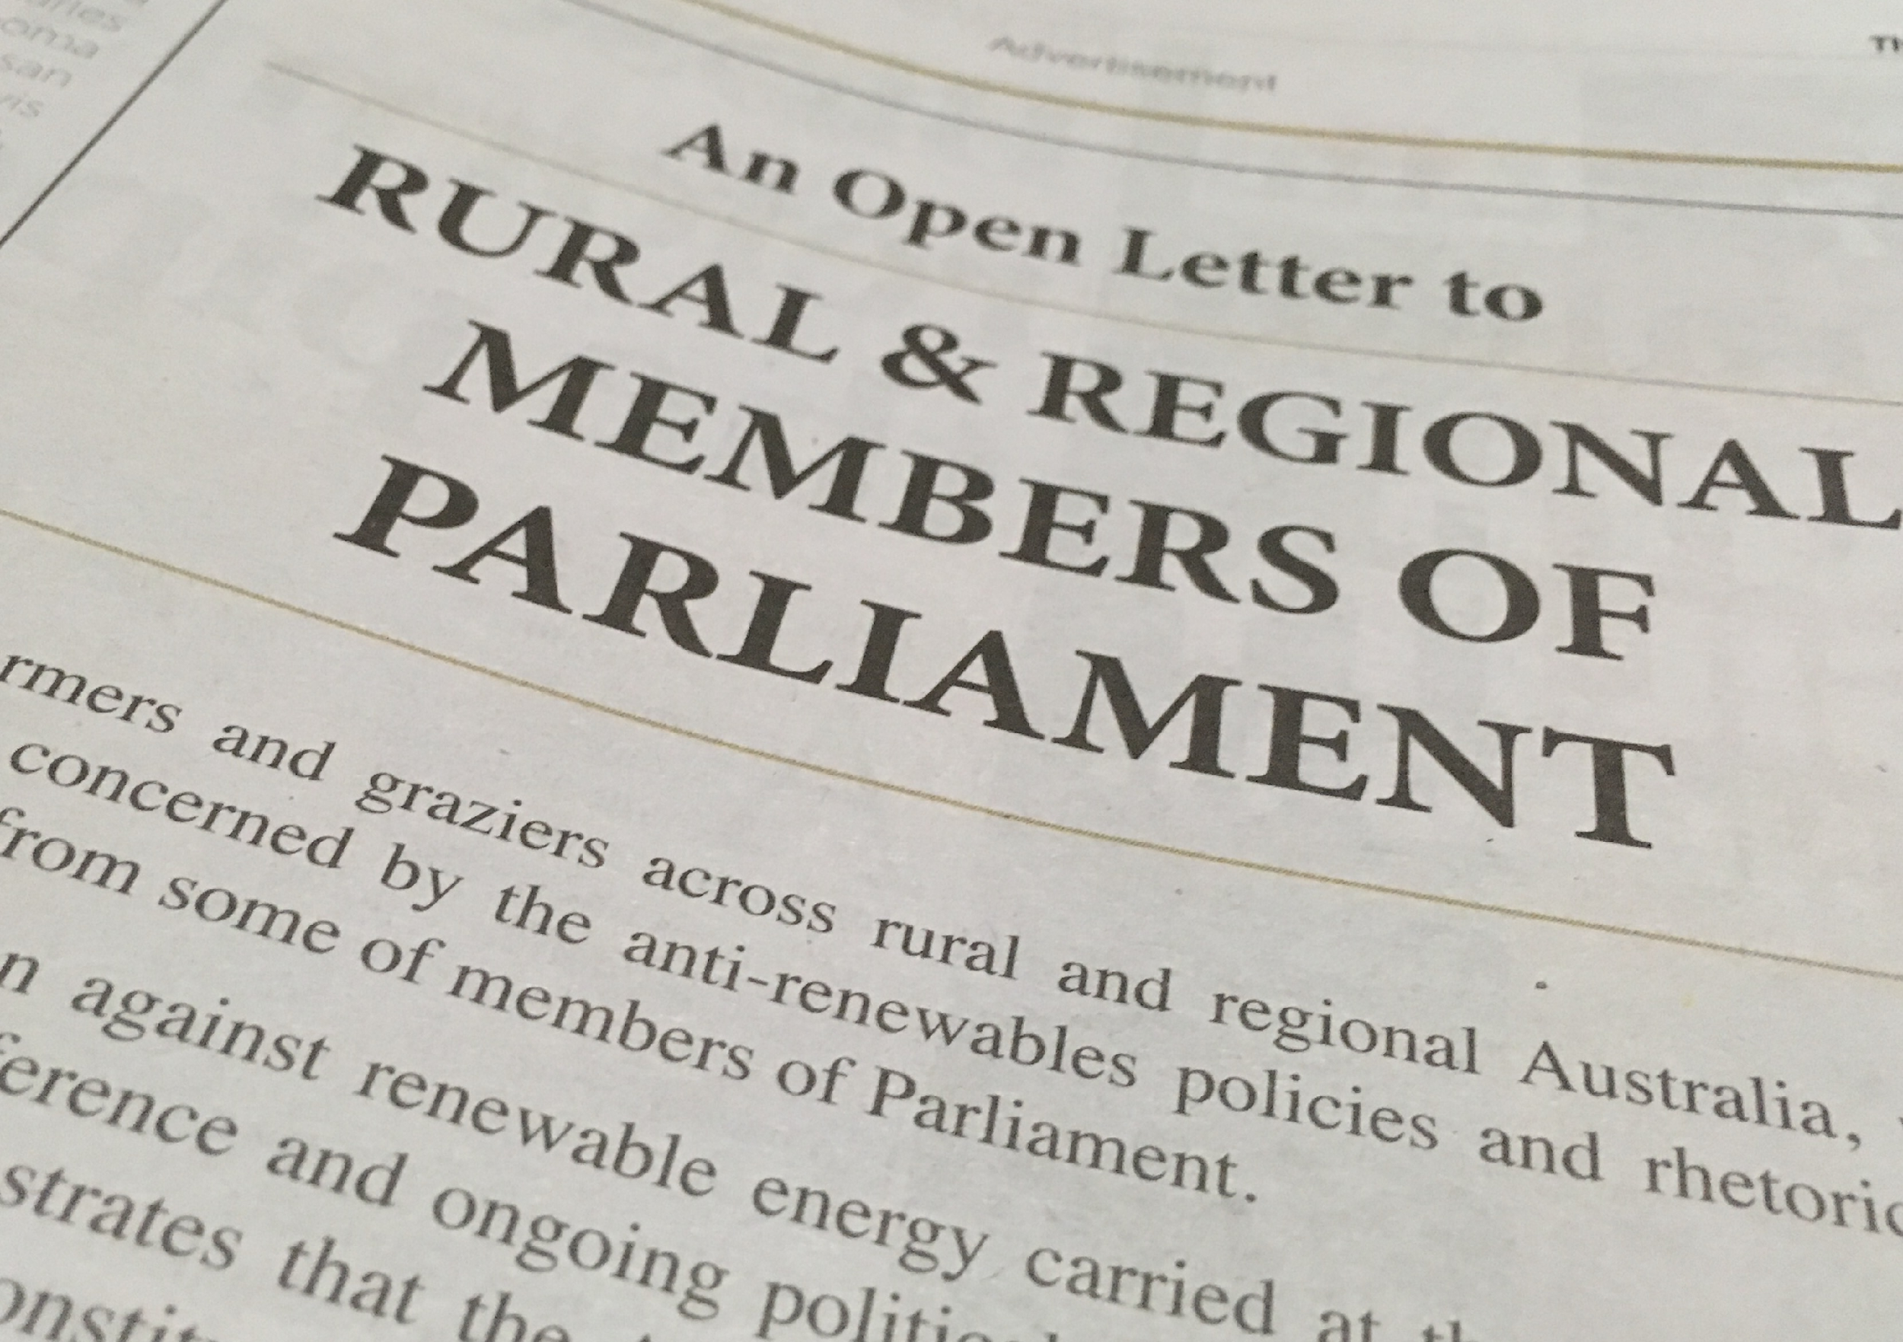

Slide 22
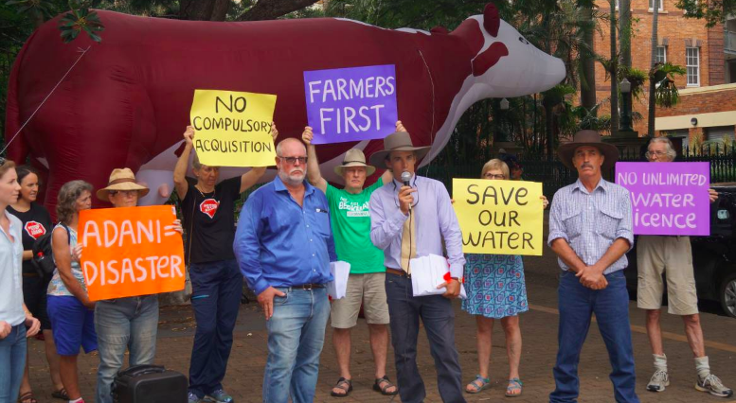
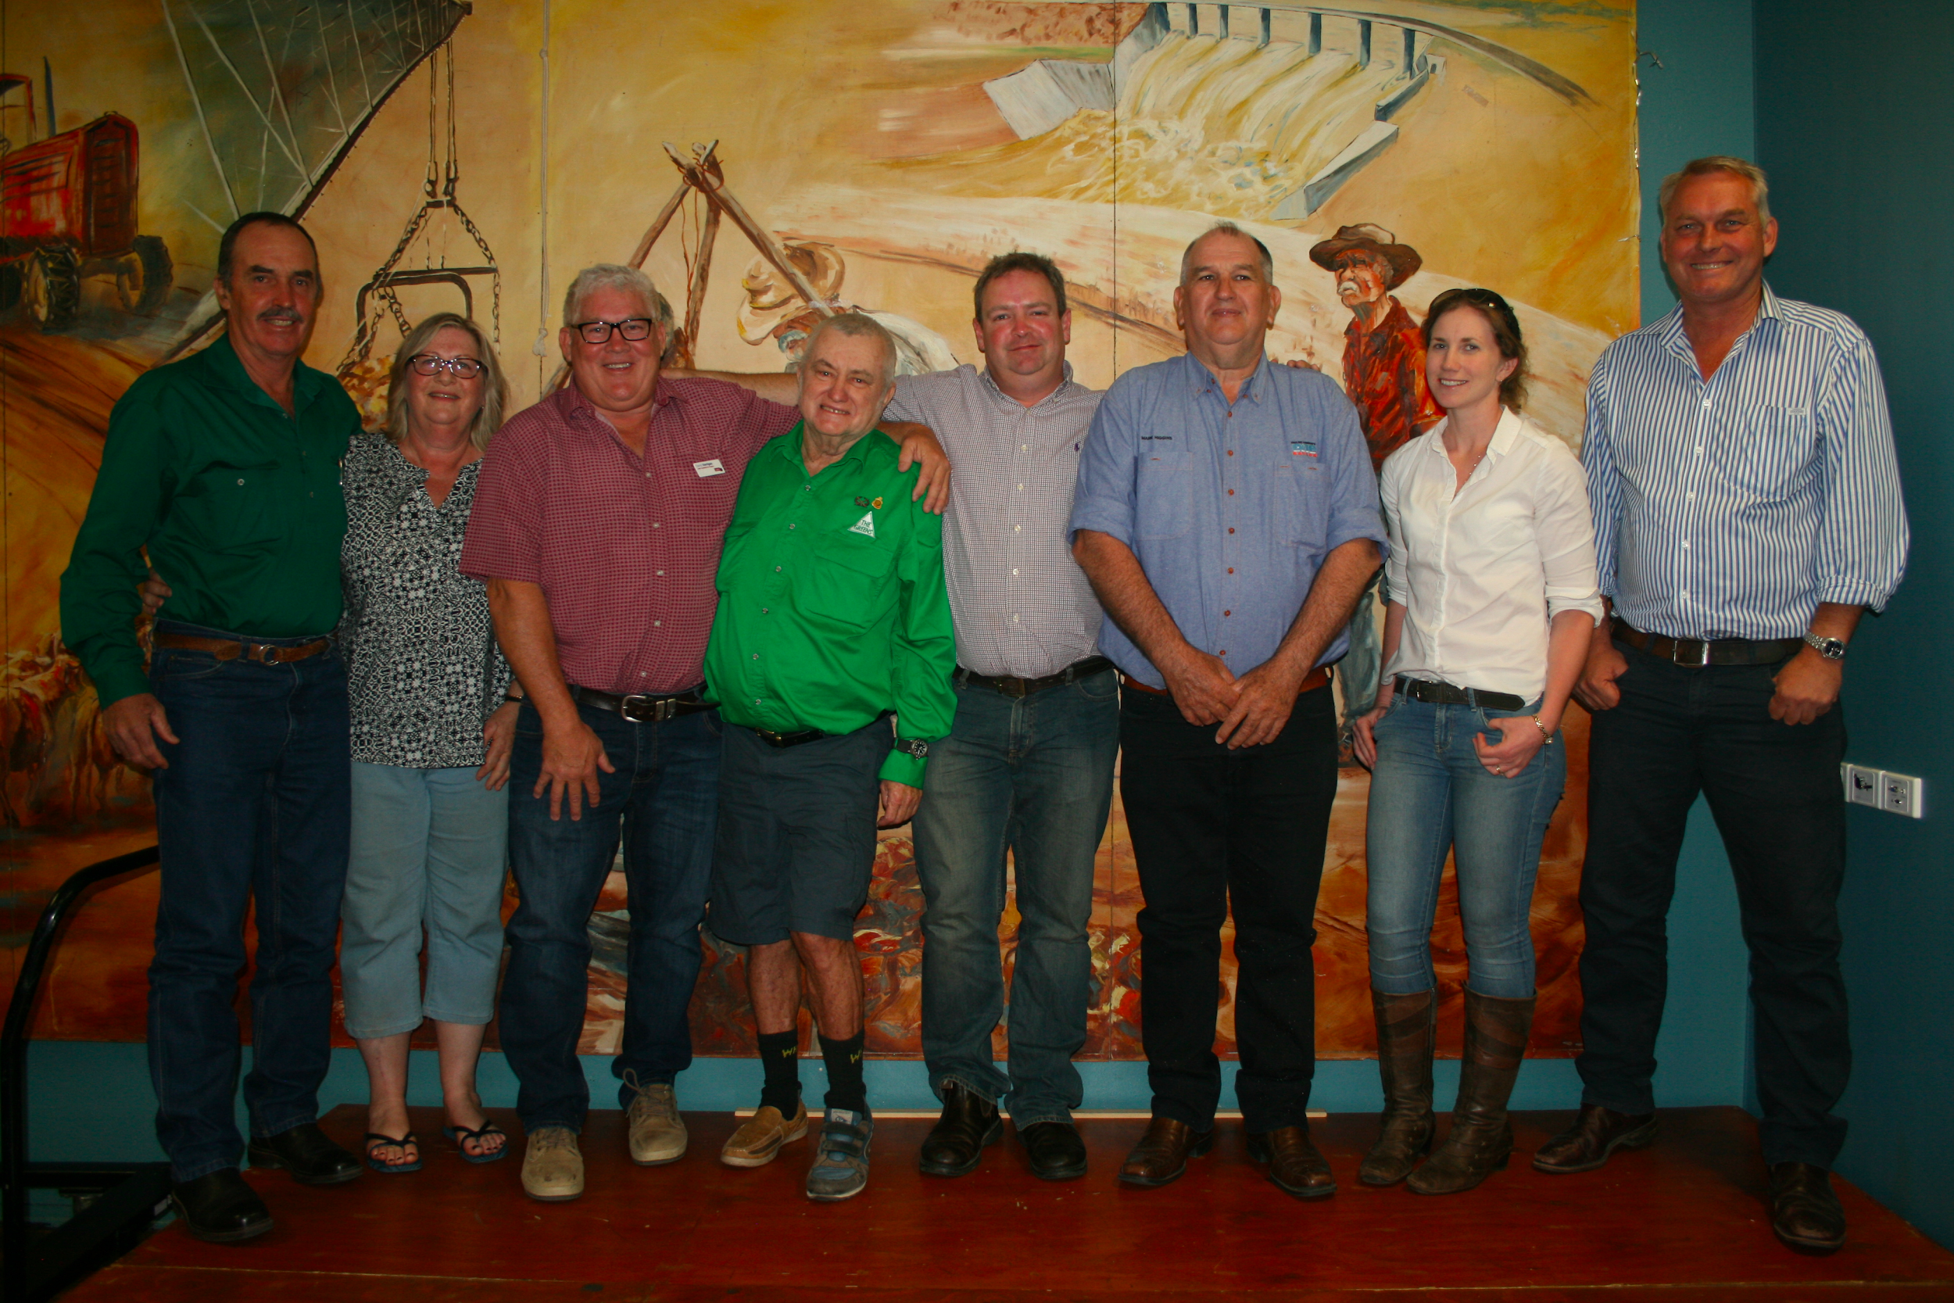

Slide 23
Rural Australia champions for climate action

Slide 24
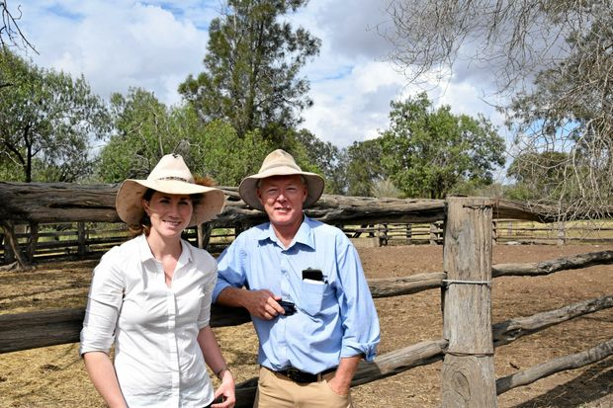

Slide 25
What can you do?
Get informed – understand the climate drivers and changing risks (CliMate & Climate Kelpie)
Take action on farm: through improved efficiencies, proactive risk management planning, integrating carbon sequestration and alternative energy technologies
Spark the conversation: support your local Landcare / NRM / production group / farm representative body to show leadership on climate issues.
Demand leadership, integrity and vision from elected representatives: our future is in our hands

